Slide 1
Stiff Integrators
Tom Krumpolc
Vibhav Dabadghao

Slide 2
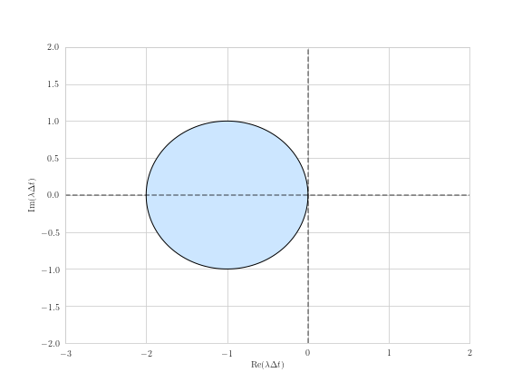
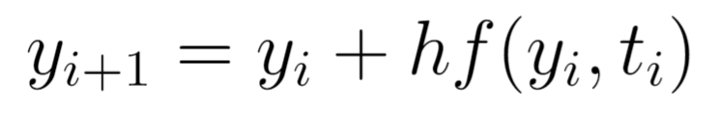
Explicit Euler: Algorithm and Stability
Simplest explicit scheme
All information known at each step

Slide 3
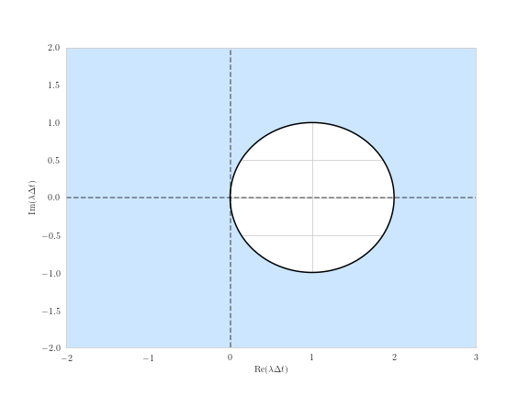
Implicit Euler: Algorithm and Stability
Simple implicit scheme
Need to solve system of equations at a given step
“A-Stable”
Notes:
Stable for any negative eigenvalues.

Slide 4
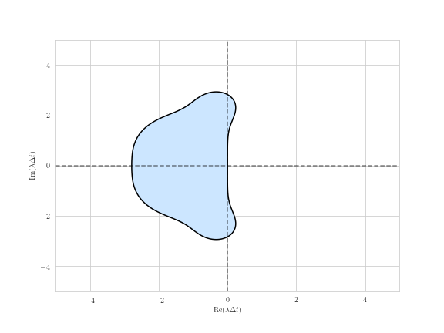
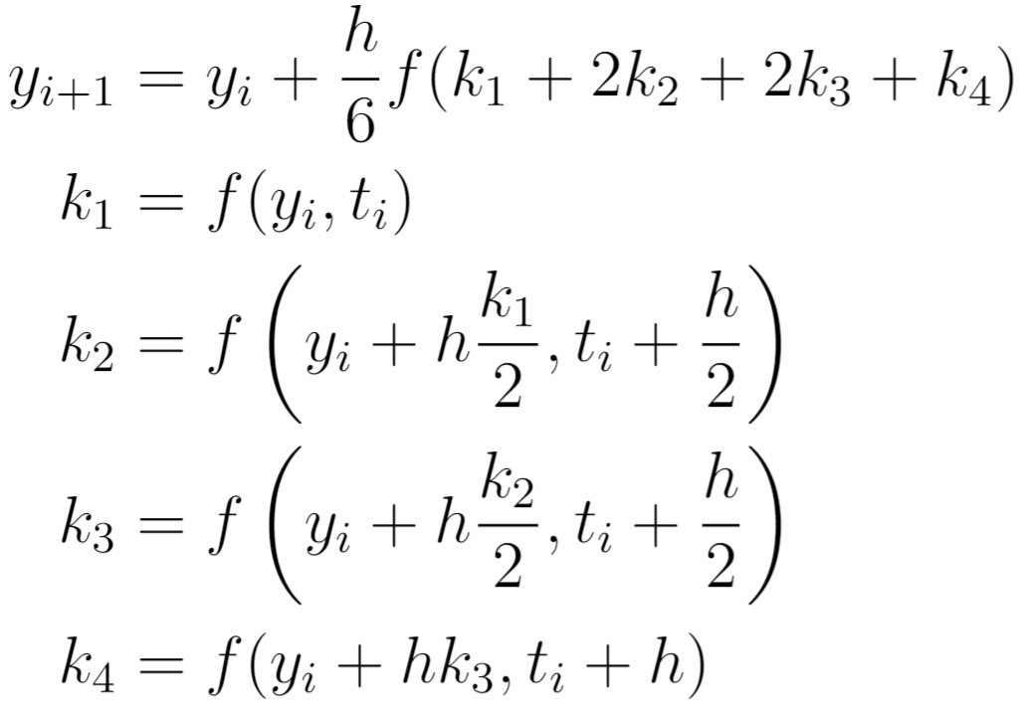
Runge-Kutta Order 4: Algorithm and Stability
Numerical scheme that takes weighted average of quantities at previous step

Slide 5
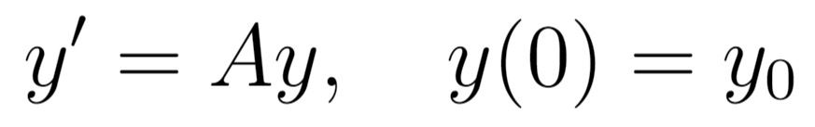
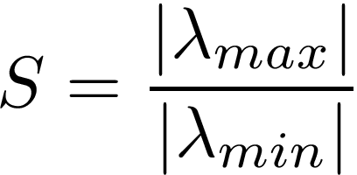
Stiffness Ratio
Ratio of the largest and smallest eigenvalues of A
Larger the stiffness ratio, the more difficult the system is to capture numerically
Eg. chemical reactions with slow and fast dynamics
Notes:
No single number or range for what problems are considered stiff. Limiting step is based on the largest eigenvalue . Eigenvalues play a direct role in the analytical solution of an ODE.

Slide 6
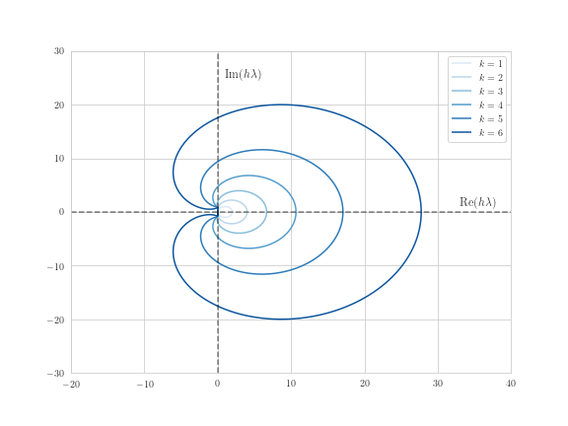
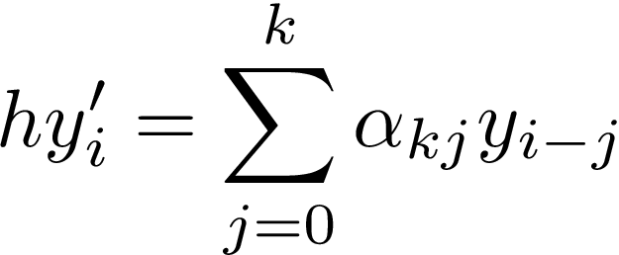
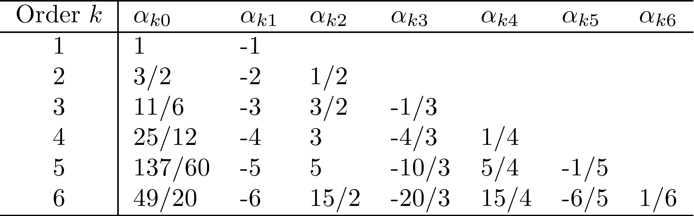
Backward Difference Formulae (BDF)
Linear Multistep Methods
y’ is approximated by a linear combination of previous and current values
kth order method requires k-1 previous steps
Notes:
Stable on outside of the graph regions. Stiffly stable

Slide 7
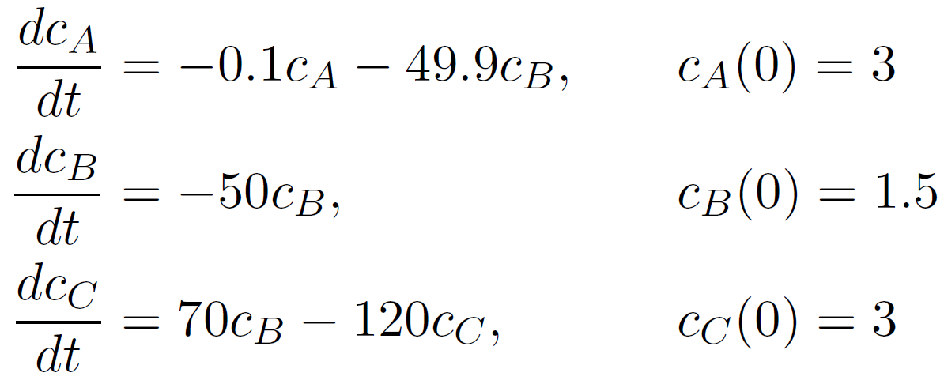

Stiff Problem
A
B
C

Slide 8
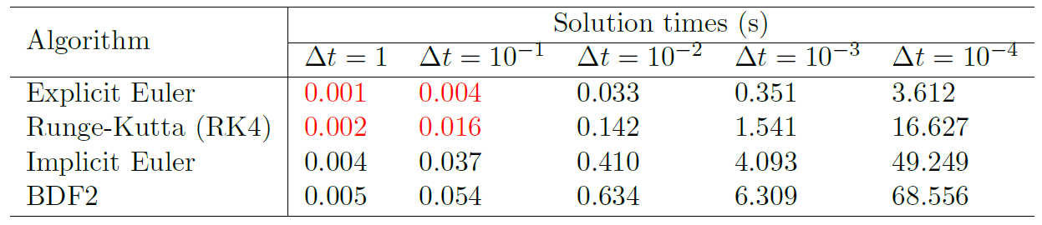
Solution Times
Explicit methods require finer discretization before exhibiting stability
Computational expense clear for fine discretizations of implicit methods

Slide 9
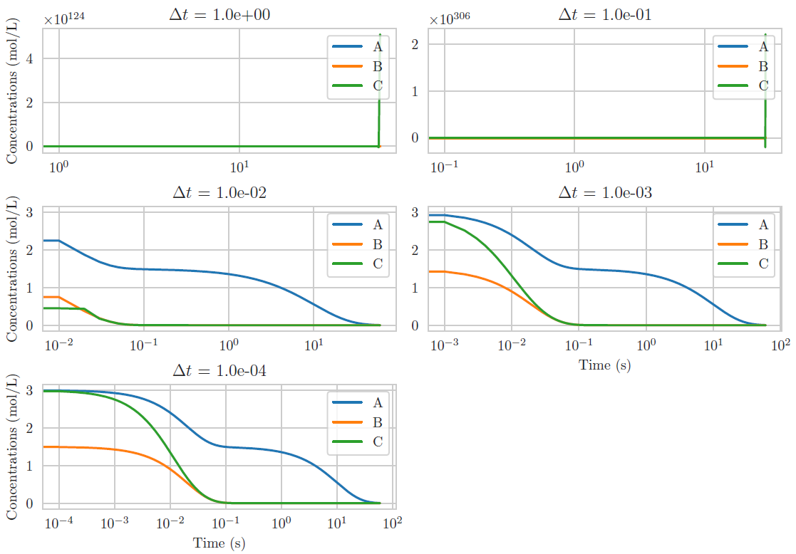
Stiff System: Explicit Euler
Log scaled on the x axis
Numerically unstable until discretized below

Slide 10
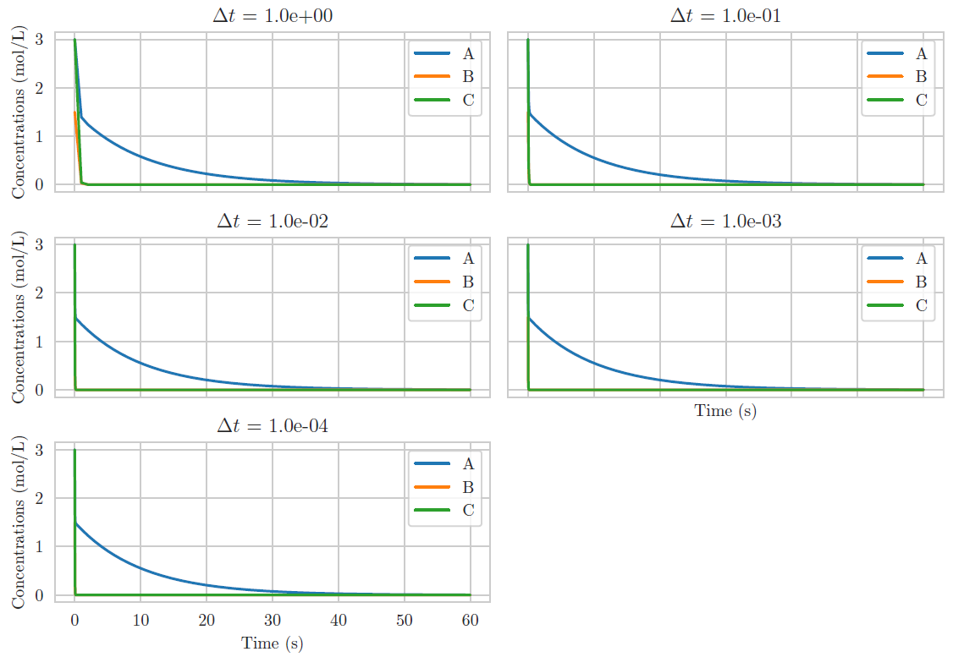
Stiff System: Implicit Euler
Not log scaled on the x axis
Stable for all discretizations

Slide 11
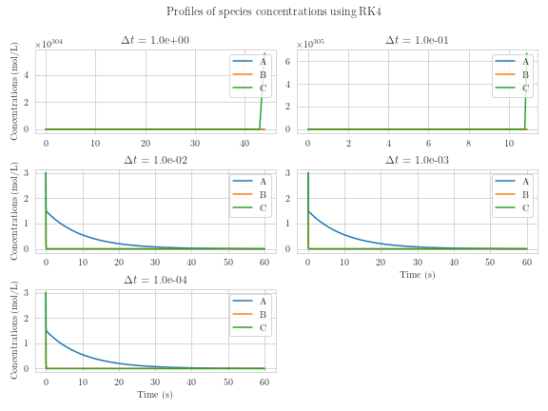
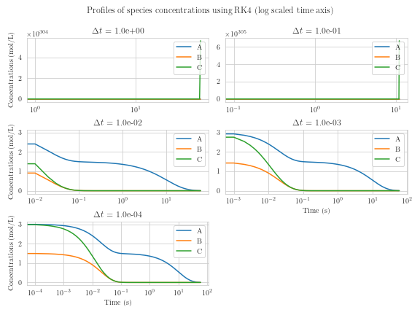
Stiff System: Runge-Kutta Order 4

Slide 12
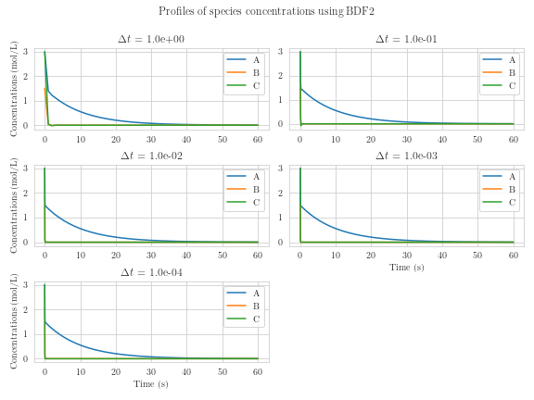
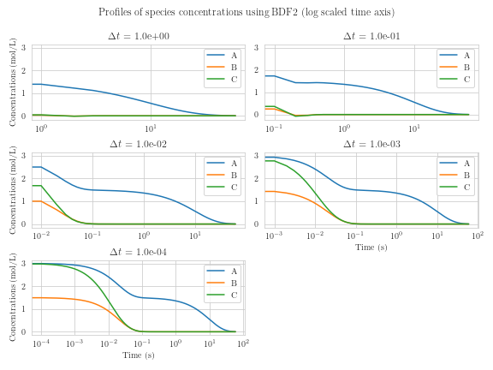
Stiff System: BDF Order 2

Slide 13
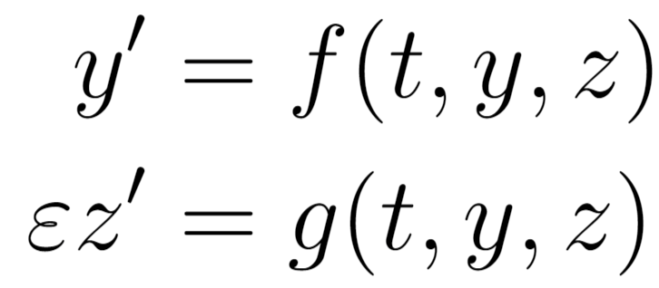
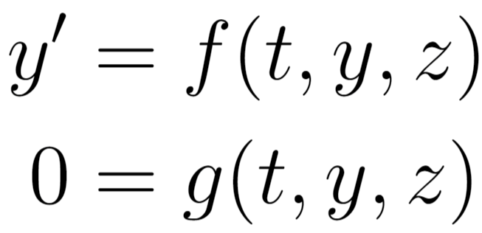
Differential Algebraic Equations (DAEs)
A stiff system (small 𝜀):
As 𝜀 → 0, we get a DAE
It is natural to consider methods for stiff ODEs for the discretization of a DAE
Notes:
Consider this system of ODEs. Our dependent variables are y and z. Here, epsilon is a small parameter. This system in general is very stiff for small epsilon. When epsilon is set to 0, this becomes a system of differential-algebraic equations, or DAEs. We say that y is a differential variable and since z does not have a differential term anymore, it is an algebraic variable. Since sitff problems and DAEs are clearly related, it makes sense to consider numerical methods for stiff problems for DAEs as well.

Slide 14
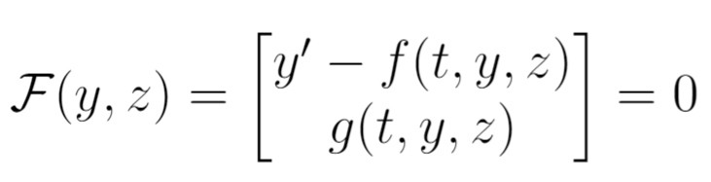
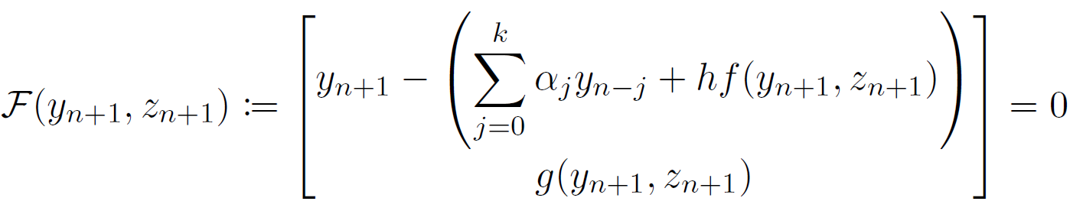
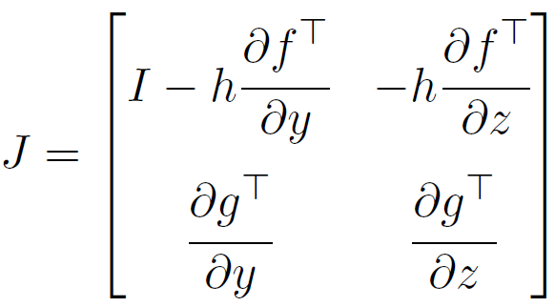
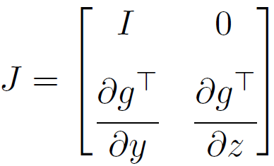

DAEs vs Stiff ODEs
Consider the DAE problem
We want to discretize and solve it using 𝑘-order BDF. At the nth step,
Need a Newton-type algorithm to solve this. The jacobian,
As
We need jacobian of the algebraic system to be non-singular.
Notes:
So, we know the two kinds of problems are related. Let's look at some key structural differences. We re-arrange the terms and represent the system as F(y,z) = 0. Now, we want to apply a k-order BDF method to solve this system. At the n-th step, our system can be written like this. We just replaced y' by the approximation formula for BDF. We want to keep things general and say that the functions f and g may be nonlinear. So, we need a Newton-type algorithm to solve this system. Recall that Newton's method requires inverting the Jacobian of the system. The jacobian wrt y(n+1) and z(n+1) can be written like this. Now, as the step size h goes to 0, the jacobian now looks like this. A quick reminder that g represents the algebraic part of our DAE. For the Newton-type algorithm to converge at each step, we require that this Jacobian be non-singular. This means that the jacobian of the algebraic system be non-singular. If it is singular, the DAE is said to be high-index.

Slide 15
Index of a DAE
Definition: The number of times that all (or part) of a DAE must be differentiated to determine 𝑥’ as a function of 𝑥 and 𝑡.
When the jacobian is non-singular, the DAE is said to be index-1
When it is singular, the DAE is said to be high-index
So, for high-index DAEs...
When 𝒉 is small, 𝐽 is ill-conditioned, instability
When 𝒉 is large, stable but inaccurate
Notes:
The index of a DAE is defined as the number of times a DAE must be differentiated to transform it into an equivalent ODE. Again, when the jacobian of the algebraic system in the previous slide is non-singular, the DAE is said to be index-1, and one differentiation of the DAE will give us an ODE. If it is singular, the DAE is high-index. So, for high-index DAEs, when h is small, J is ill-conditioned and the solution is unstable. When h is large, the solution may be stable but it is inaccurate.

Slide 16
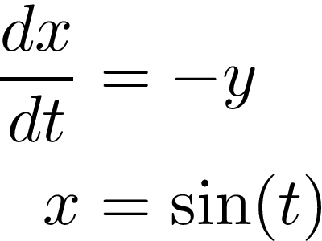
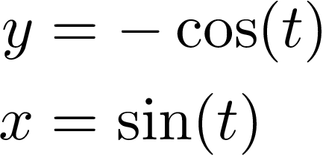
DAE Index 2 System
Algebraic variable y not present in the algebraic equation
After one differentiation and substitution, resulting system is one differentiation from and ODE system
Reduced (Index-1) System
Notes:
Lets consider an index-2 DAE system. We have two equations dxdt = -y and x = sin(t). x is a differential variable and y is an algebraic variable. since y does not appear in the algebraic equation, the jacobian from our previous slide will be singular. We can differentiate the 2nd equation and substitute from the first equation to give us an equivalent system. Now if we notice, it is not easy to come up with the correct initial conditions for x, since it must satisfy the algebraic equation. For this problem, we can figure out the initial conditions from the system on the right.

Slide 17
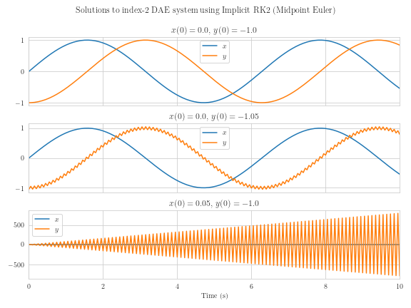
Midpoint Euler: Index 2 System
Stable for correct initial conditions
Unstable for any perturbations in x or y
Notes:
We applied an implicit RK method on the original high-index to see how it performed. For the corrent initial conditions, we obtain accurate profiles. If the initial condition for y is perturbed, the solution exhibits some unstable behavior. If we perturb the initial conditions for x, it is very unstable.

Slide 18
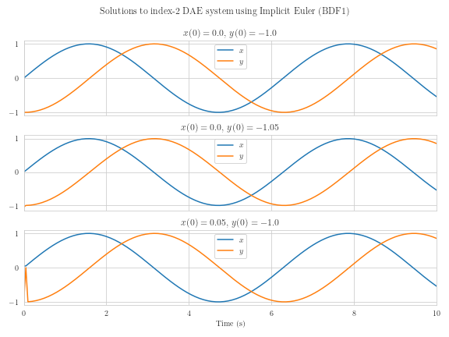
Implicit Euler: Index 2 System
Stable for correct initial conditions and perturbation in y
Able to recover from inconsistent initial conditions when x is perturbed
Notes:
Now if we apply a BDF method on the same problem, it turns out that the numerical solution is able to recover fairly quickly from the wrong initial conditions.

Slide 19
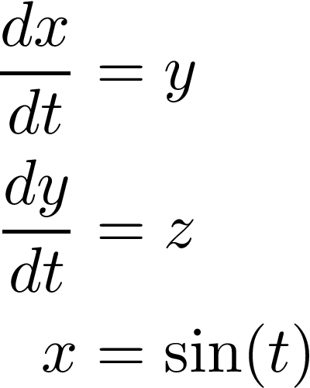
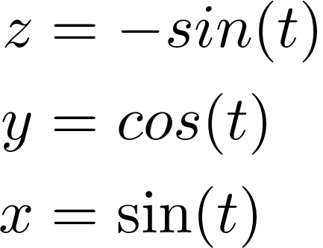
DAE Index 3 System
Requires two differentiations and substitutions
Notes:
Let's look at an index-3 DAE system. We have 3 equations. x and y are differential variables and z is an algebraic variable. Again, the jacobian of the algebraic system is singular, and after two differentiations, we can obtain the system on the right-hand side.

Slide 20
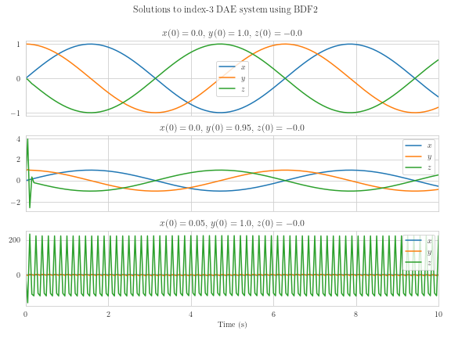
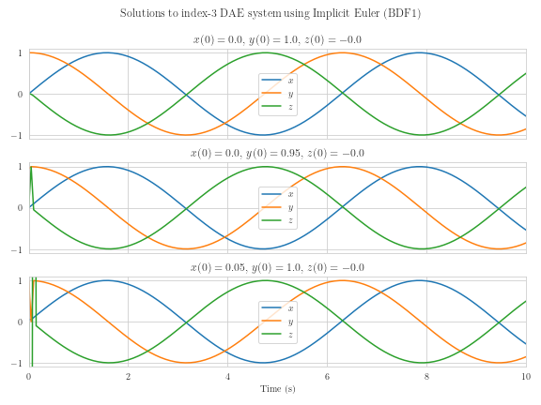
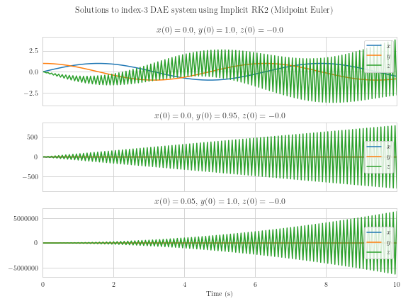
Midpoint Euler: Index 3 System
Unstable even for consistent initial conditions
Notes:
Again, we apply an implicit RK method, but the solution seems to be unstable even for correct initial conditions. This behavior is unexpected, but it shows that consistent initial conditions are critical for high-index systems.

Slide 21
Implicit Euler: Index 3 System
Stable for consistent initial conditions
Able to recover from inconsistent initial conditions when x or y is perturbed
Notes:
Agan BDF1 seems to recover fairly quicky from wrong initial conditions.

Slide 22
BDF Order 2: Index 3 System
Stable for consistent initial conditions
Able to recover from inconsistent initial conditions when y is perturbed
Strange behavior for perturbation in x
Notes:
We also tested this using BDF2 and we found an unexpected result. It turns out BDF2 becomes unstable for the 3rd case, while BDF1 is stable. BDF2 should ideally perform as well as BDF1, but for our test problem, it turned out not to. This may be a problem specific behavior, and perhaps higher order methods would be stable, that is something we can look at in the future.

Slide 23
Conclusions
Stiff systems restrict the numerical scheme
BDF implicit methods perform better than Explicit Euler and Runge-Kutta family of methods
Consistent initial conditions are necessary for high index systems
In many cases, we need to perform index reduction (non trivial)
Notes:
To conclude, we learned what stiff systems are and how they restrict the numerical scheme. We demonstrated that BDF methods perform better than explicit and RK family of methods. We saw how consistent initial conditions are necessary for high-index systems, and BDF methods would be the recommended choice to solve them. We will end this presentation by saying that, when dealing with high-index DAEs, in many cases we need to to perform index reduction, which is a non-trivial procedure.

